Slide 1
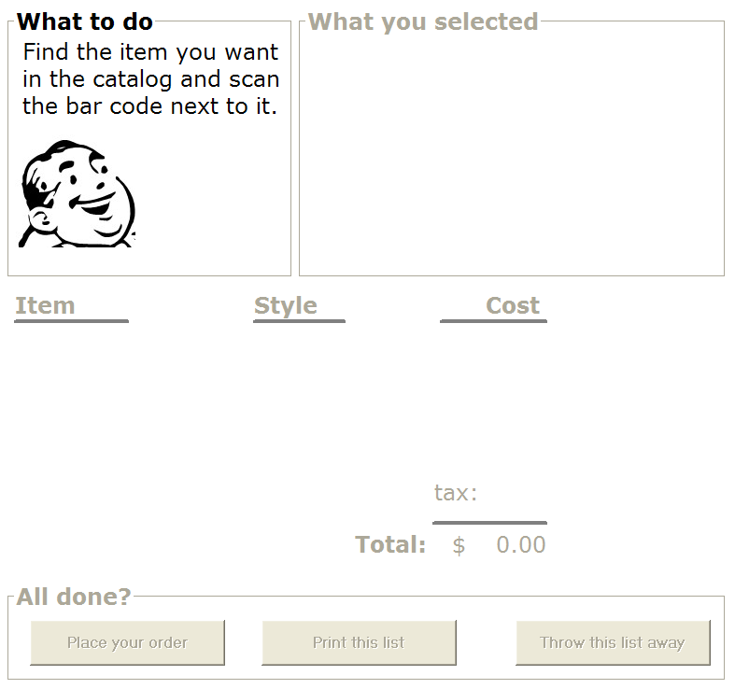
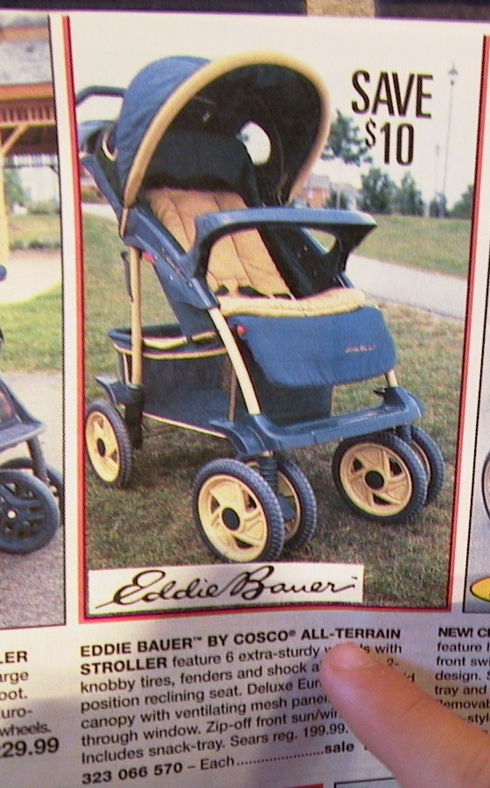

Slide 2
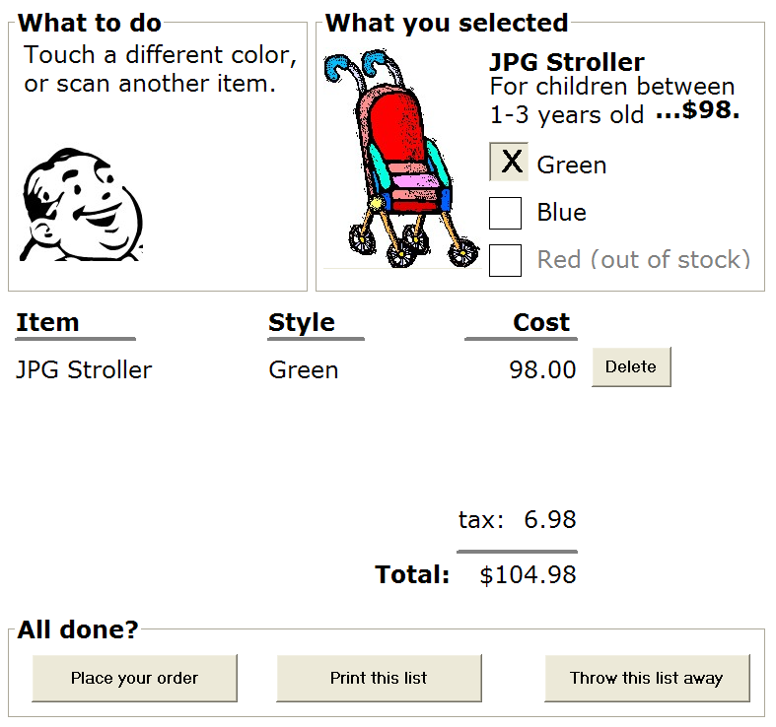

Slide 3


Slide 4


Slide 5
Printing…
To recall this order, scan the bar code on the printout

